Slide 1
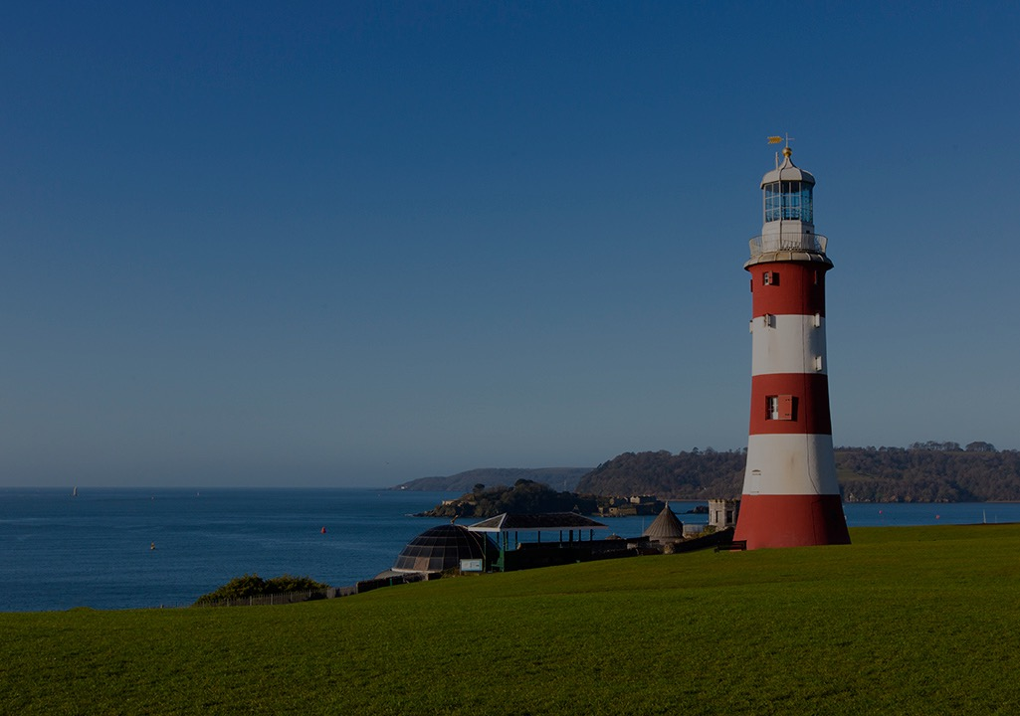
Image compression
Martin Read
Notes:
Welcome to the session on introducing API’s.

Slide 2
Common File Formats for the Web
The three most common file formats on the web are:
JPEG (.jpg)
GIF (.gif)
PNG (.png)
Most programs have their own file format called a native format
formats are unique to the program
you can save without losing any information
use no compression or lossless compression

Slide 3
Introduction
Image: spatial representation of an object or a scene
Graphic: a broader & general definition including
Pictures or Photographs
Drawings or Line arts
Clip arts
Buttons and Banner
Charts and graphs
Backgrounds
Icons

Slide 4
Types of Graphics
There are two basic types of graphics:
Bitmapped Graphics
Vector Graphics
Vector Graphics
Created & manipulated using drawing programs
e.g. Corel Draw & Acrobat
Image described using shapes

Slide 5
Bitmap graphic
AKA pixelized graphics
Most common & comprehensive form of storage for images
Uses pixels (combination blocks of different colours) to represent an image. Each pixel assigned a specific location & colour value
The more pixels you have, the more detailed the image

Slide 6
Bitmap Images
Most common, especially on the web
Very flexible
Any image can be represented (with enough pixels)
Created by scanners, digital cameras, etc
Takes a lot of memory
but can be compressed

Slide 7
Colour Depth
Image formats only allow a certain number of different colours for each pixel
Depends on the number of bits assigned to each pixel
Format stores the level of each of the 3 values (RGB) to specify colour
Bit depth describes the number of colors that can be used in the image
A 24-bit image allows you to specify up to 2²⁴ different colours in your image

Slide 8
Image resolution
Measures the pixel dimension of an overall image or how many pixel the image has
Image resolution is measured in width & height
e.g. 100 * 100-pixel image has a total of 10,000 pixels

Slide 9
Display resolution
also measured in pixels in terms of height & width
how many pixels can be displayed on a computer screen
Display resolution normally uses:
640x480(VGA), 800x600 (SVGA), 1024x768, etc.
Can change display resolution under Display Properties in Control panel.
If image resolution is bigger than display resolution
part of the image will be out of the display area

Slide 10
Memory/Storage requirement
Factors to consider:
height of the graphics
width of the graphics
colour or bit depth
The file size of a bitmap image (in bytes):
Height X Width X (Colour depth / 8)

Slide 11
Common File Formats
Each file format converts the image to a corresponding string of bits differently in order to store them on disk or transmit over the Internet
GIF: graphics interchange format
JPEG: joint photographic experts group
PNG: portable network graphic
BMP: Windows bitmap
TIFF: tagged image file format

Slide 12
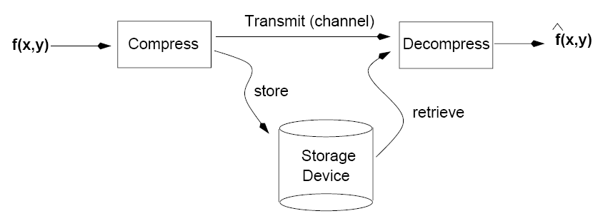
Image Compression

Slide 13
Image Compression
Compression is used to make files smaller
but takes time to compress & decompress a file
Bitmap images, especially, can be quite large if stored without compression
Ex. A 640 x 480 pixel image with 24-bit color depth would take:
640 * 480*24 bits = 7372800 bits = 900kB
Windows bmp format is uncompressed
Should NEVER be used online

Slide 14
Lossy vs. Lossless Compression
Lossless algorithm - when an image is compressed & later uncompressed, image is exactly the same
Most common type - No information is lost
Low compression ratios
Lossy algorithms produce images which may be slightly different before compression & after uncompressing
Some information may be lost
Can sometimes produce much smaller files
Can be used when the difference isn’t very noticeable
Often takes into account human anatomy
we can’t tell the difference between certain values of colour

Slide 15
Compression
Can produce images with:
blocky effects
decreasing image quality

Slide 16
JPEG (Joint Photographic Experts Group)
Usually lossy compression – very lossy!
discards most of information to keep image file size small
meaning some degree of quality also lost
people do not perceive effect of high frequencies in images very accurately - can be discarded without perceptible loss of quality
Format designed for photographs at high quality
Continuous-tone pictures
24-bit color or 8-bit gray-scale
Like you’d get from a digital camera or scanner
Suitable for many applications

Slide 17
GIF (Graphics Interchange Format)
Lossless compression
Used a lot on the web
Good for simple animations
Limited to 8-bit colour (256 colours)
Compression algorithm is patented

Slide 18
PNG (Portable Network Graphic)
Lossless compression
Replacement for GIF - no patent!
Better compression algorithm than GIF
Supports 24-bit colour

Slide 19
TIFF (Tagged Image File Format)
Lossless compression
Mainly used for exchanging documents between different applications & computer platforms

Slide 20
Object Relational Mapping
Entity Framework
Expected to use
Not expect you to use anything else

Slide 21
Code First
Can use DB first
but materials not there
might not quite work
will scaffold lots of stuff that you cannot use
will get in the way & will break things
Should only scaffold the things you need

Slide 22
Tools, databases, languages
Not one thing that everybody uses
depends on the context
generally businesses buy into MS infrastructure because they get a lot of support
lots of people know how to use them

Slide 23
Azure Data Studio
Viewpoint into your database
MS tool
platform for cloud computing
industry standard
free to the Uni
Use any tool that lets you view the database
Jet Brains DB

Slide 24
MS SQL Server
Robust industry standard
quite complex, Relational DBMS
need to have that understanding
Others prefer Open Source approach, e.g. MySQL
loads of resources online
Others use ORACLE

Slide 25
NoSQL databases
Moving to a world where you will see NoSQL databases
e.g. MongoDB & document databases
Smaller startup companies want open source document style databases
a lot of the time because they don’t want to do ERDs or to Normalise
Excel – is a spreadsheet, not a database

Slide 26
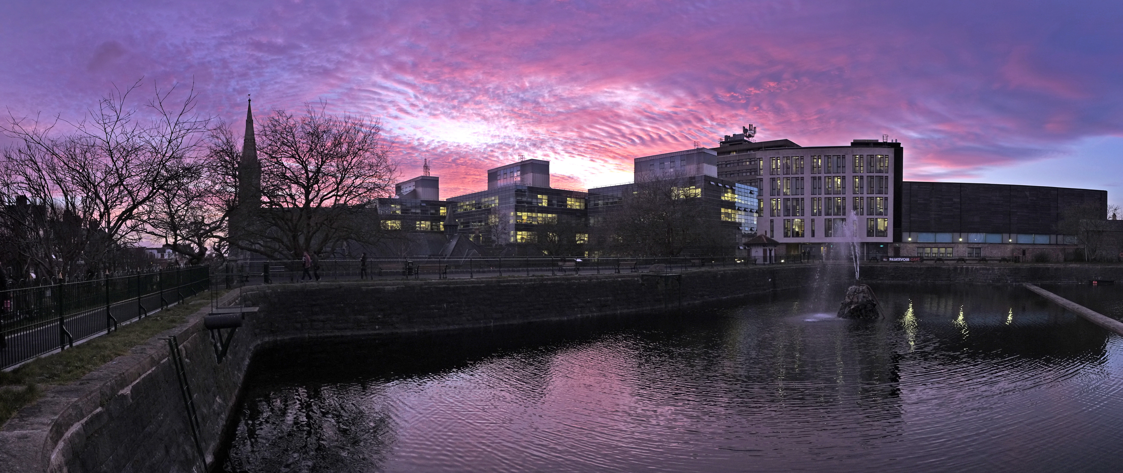
University of Plymouth
Advancing knowledge, transforming lives

